Slide 1


NFL Statistical Analysis
By: Vincent Zimmerman

Slide 2
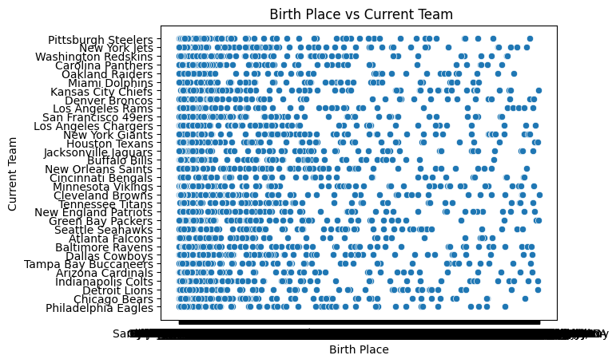
Birthplace of NFL Players vs Current Team
. KS Test: .997
. Chi squared test: p-value 1
. r-squared: .0016
. Accuracy .82

Slide 3
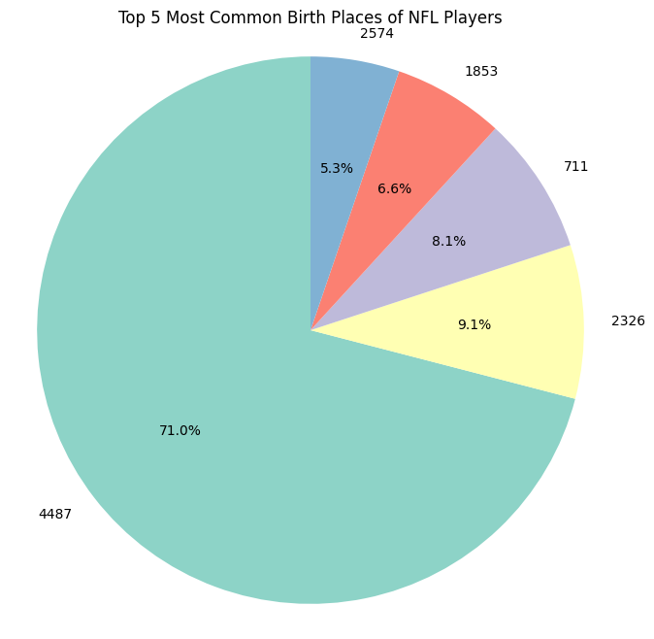
Research Question 1: Where is the Majority of NFL Players Born?
1. Los Angeles, CA (4487)
2. Chicago, IL (2326)
3. Houston, TX (2574)
4. Miami, FL (1853)
5. Dallas, TX (711)

Slide 4
Research Question 1 PT.2:
Los Angeles, CA had a total of 71% of NFL players born there
Chicago, IL had a total of 9.1% of NFL players born there
Houston, TX had a total of 8.1% of NFL players born there
Miami, FL had a total of 6.6% of NFL players born there
Dallas, TX had a total of 5.3% of NFL players born there

Slide 5
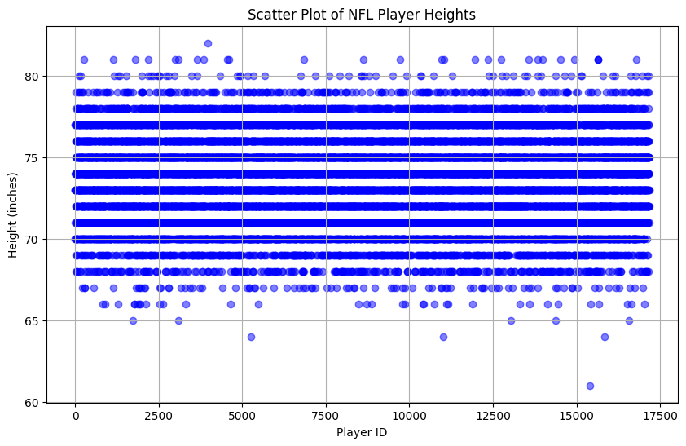
Research Question 2: What is the Average Weight and Height of NFL Players?
Average Height of NFL Players: 73.51 inches

Slide 6
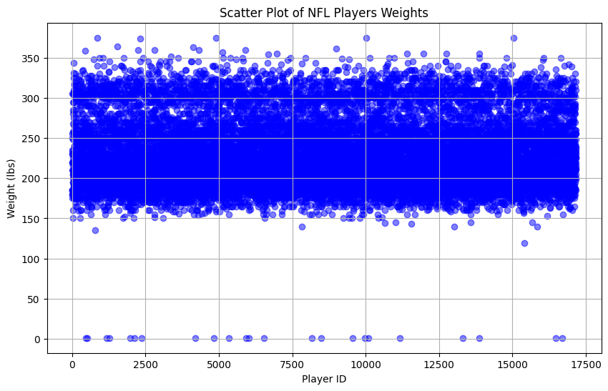
Research Question 2 PT 2: What is the Average Height and Weight of NFL Players?
Average Weight of NFL Players: 229.22lbs

Slide 7
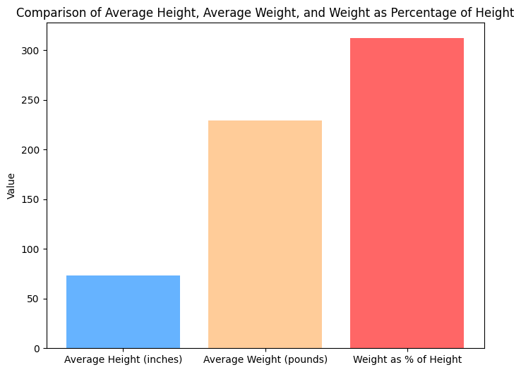
Final Analysis Research Question 2:
Percentage of Average Weight Compared to Average Height 311.83%

